Slide 1
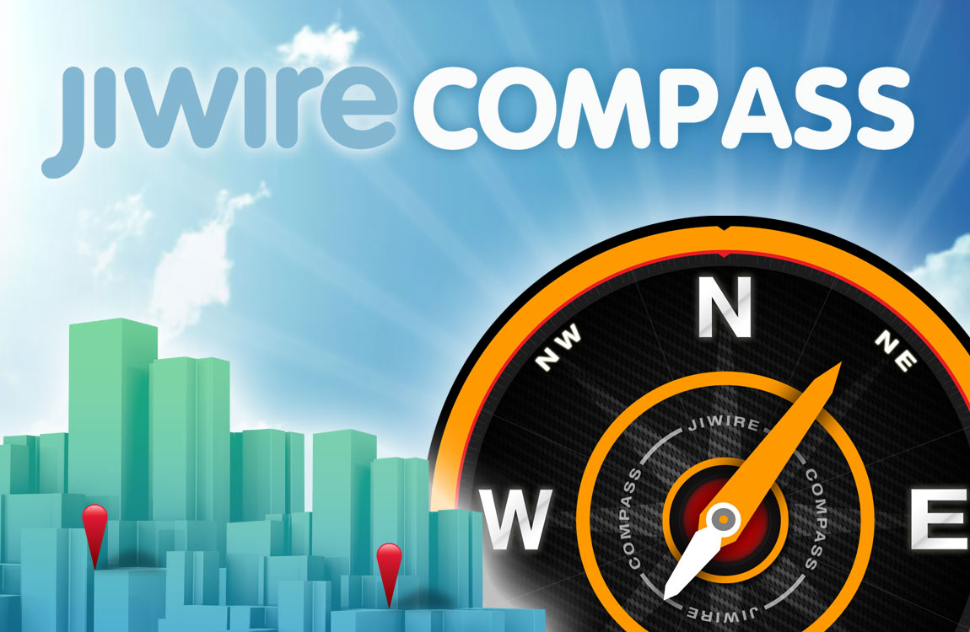

Case Study

Slide 2
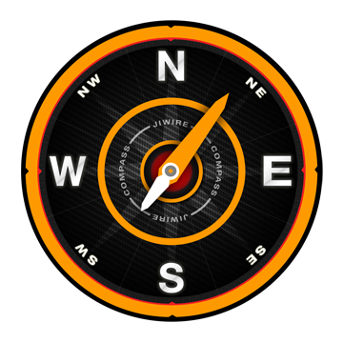
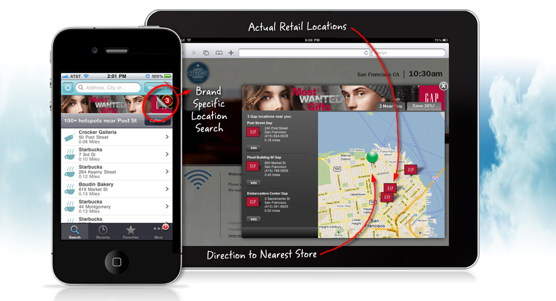
The Ad Becomes the App
An app-like location experience for every brand

Slide 3
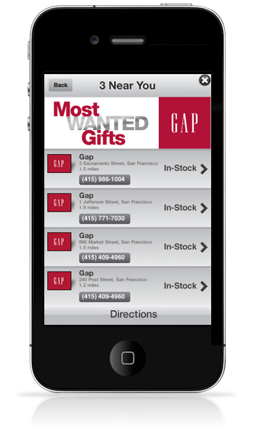
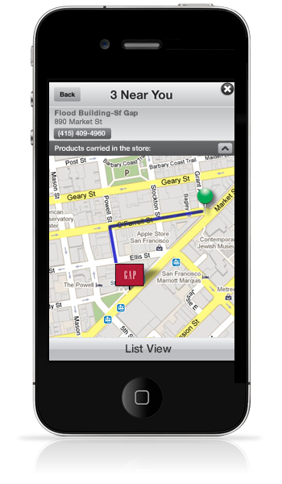



Extending Location to All Companies
75% of Fortune 500 companies don’t have physical stores
Any Brand Location
Your Stores or Where Your Product is Sold
Product Availability
Over 3M products pre-integrated
Directions for Each User
Convert to drive In-Store Sales

Slide 4
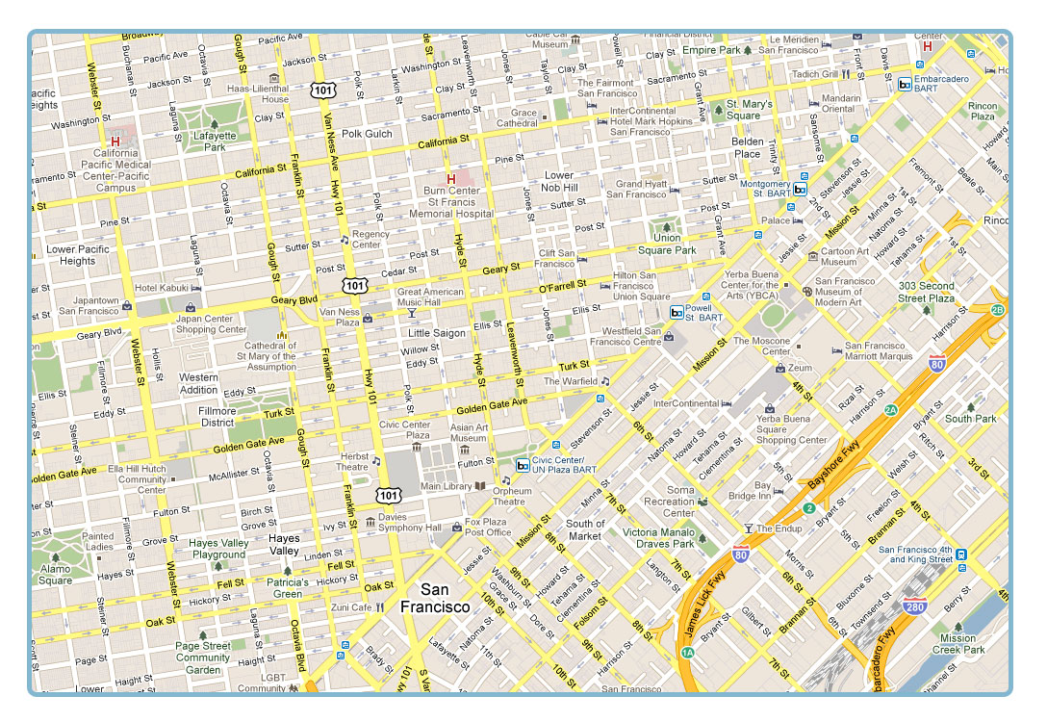
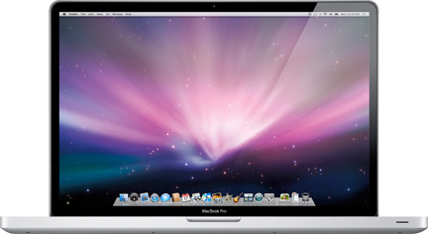
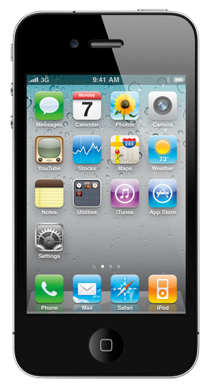

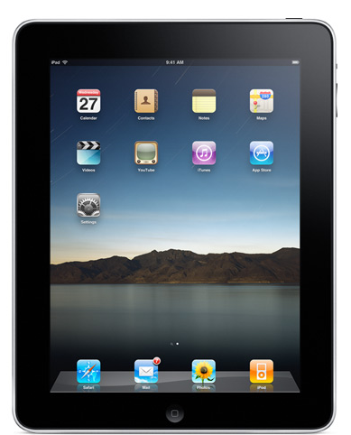
GAP and JiWire Compass
Location-Based Advertising on Any Device

Slide 5
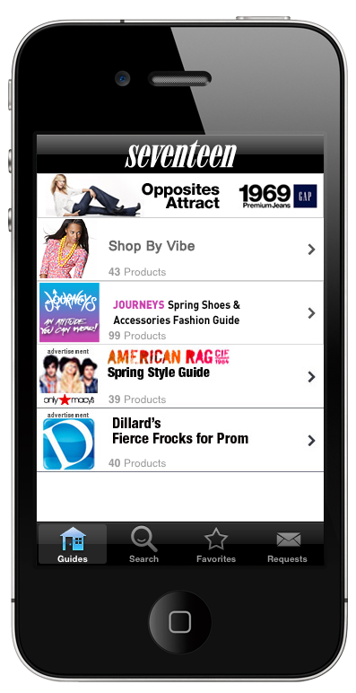



GAP and JiWire Compass
Mobile

Slide 6
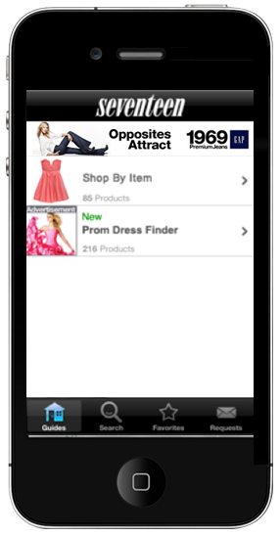
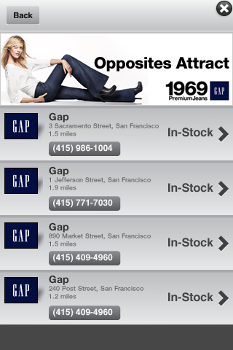
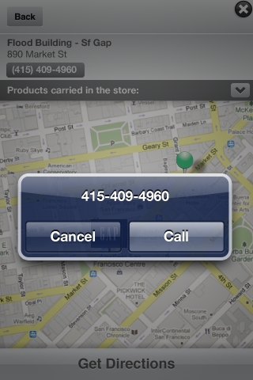
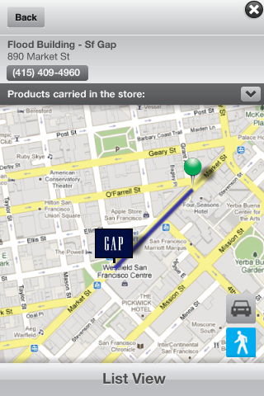
GAP and JiWire Compass
Mobile

Slide 7
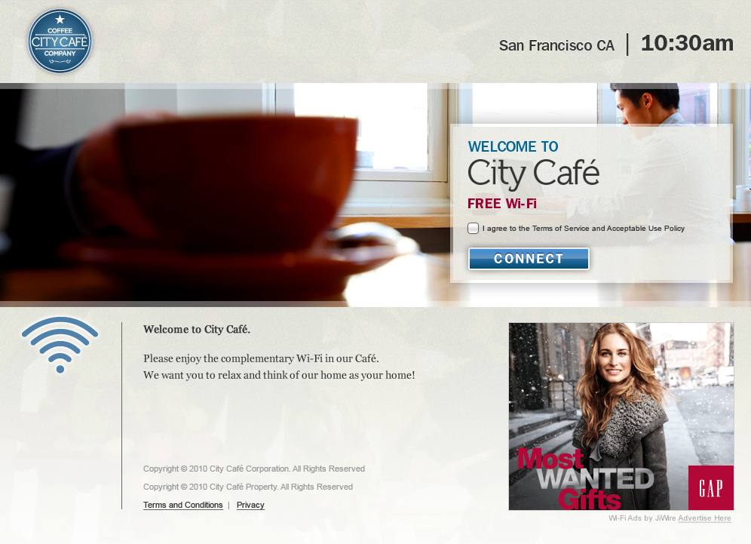

GAP and JiWire Compass
Cross-Channel

Slide 8
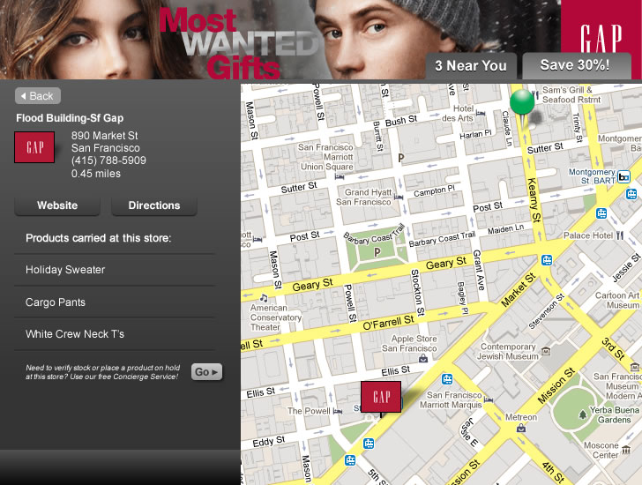
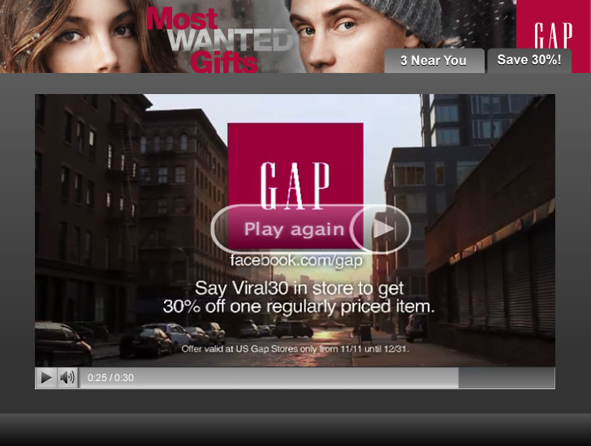
GAP and JiWire Compass
Cross-Channel

Slide 9








Overall Compass Results
Advertisers
3X higher
25%
>1 Minute
Click-Through Rate
Take Multiple Actions
Average Time Spent

Slide 10
Campaign Insights
Proximity Marketing

Slide 11
Strong Performance at Broad Distances
Expansion Rate
2.9x
1.6x
Normal Performance
1
2
5
10
20
Proximity to Store Location (miles)

Slide 12
Strong Performance at Broad Distances
Post-Expansion Engagement Rate
Custom Engagements (e.g Video)
1
2
5
10
20
1
2
5
10
20
Store Proximity (miles)
Store Proximity (miles)

Slide 13

Consumer Activities Differ by Device
Store Detail Views
Walking/Driving Direction Views
+15%
+270%
Wi-Fi
Mobile
Wi-Fi
Mobile

Slide 14
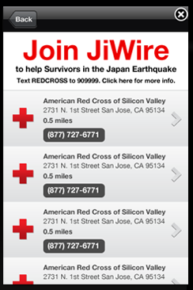
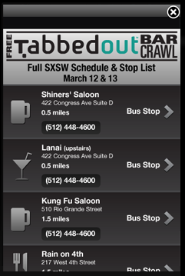
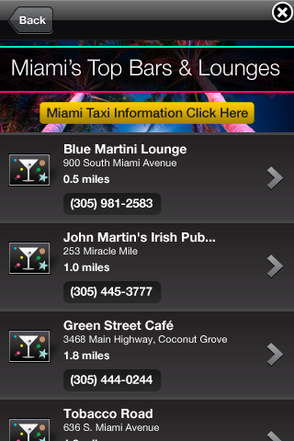
Location: For More Than Just Brands & Merchants

